Slide 1
The Workflow of Data Analysis
Gallon
2021/07

Slide 2
The advantage of doing workflow
Identifying Redundancies
When you do an data project, sometimes, there are some repetitive works or useless steps on your process. Drawing a workflow and identifying the meaning of every step can make the project more efficient.
Making Knowledge be Accumulated
Being a data analyst, your must keep learning. Thus, you will get some new business insights or new technical skills. A workflow can make you easier to understand where the new method should put.
Establishing Your Own Process of Data Project
Nest time, when you face similar data project, you could directly copy previous workflow and adjust it.
Additionally, in interview, when you be asked how to do a data project, you could step by step to answer.

Slide 3
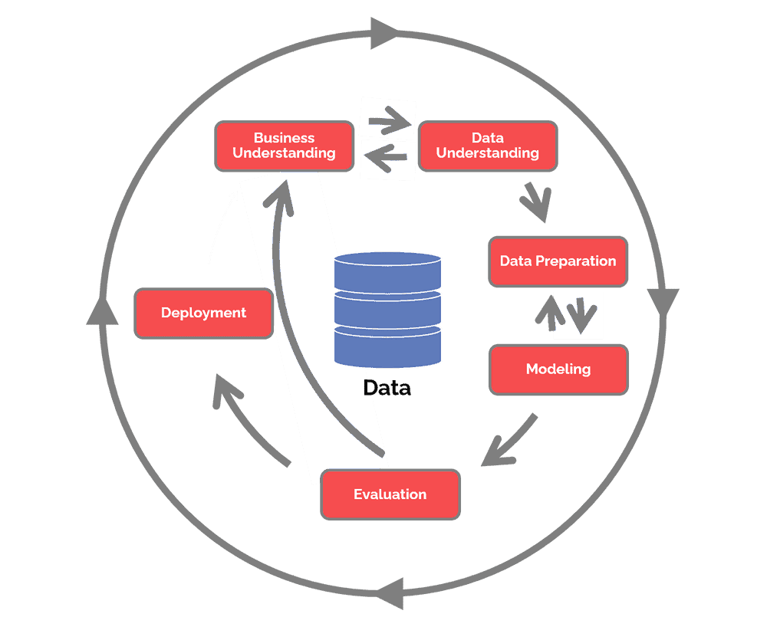
CRISP DM
CRISP DM (CRoss Industry Standard Process for Data Mining)
Data Understanding
Collect initial data
Describe data
Explore data
Verify data quality
Data Preparation
Select data
Clean data
Construct data
Integrate data
Format data
Reference: https://www.datascience-pm.com/crisp-dm-2/

Slide 4
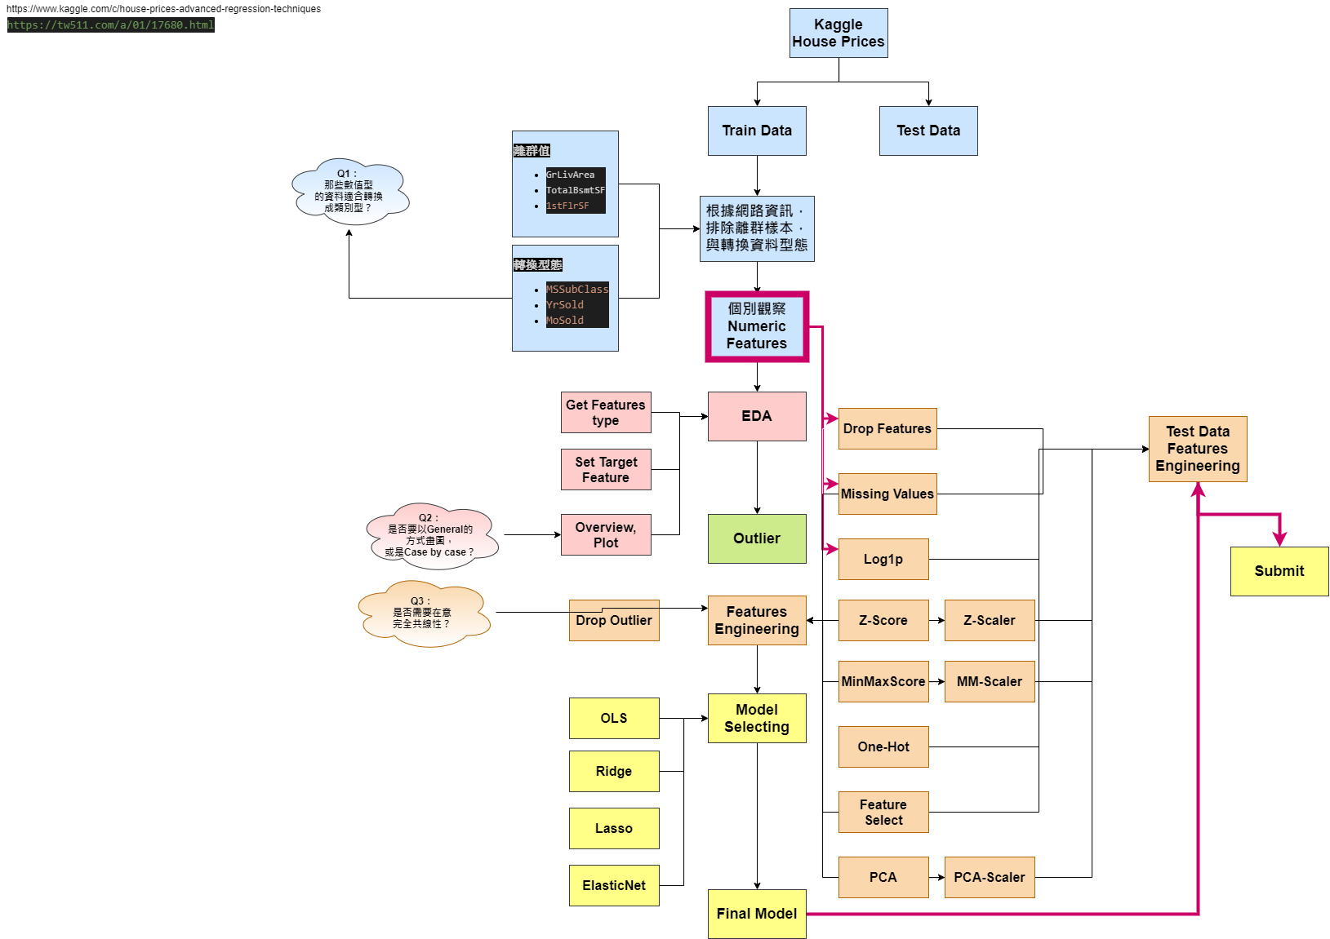
My workflow of “House Prices” in kaggle
It is my first try of workflow, so the graph is very ugly and messy.
However, we can improve it next time.

Slide 5
My workflow of “House Prices” in kaggle
Data Understanding
Data Preparation

Slide 6
My workflow of “House Prices” in kaggle
Data Understanding
Data Preparation

Slide 7
Thank you!
Gallon Shih
gallonshih0526@gmail.com
+886 979028669
If you have any question or suggestion, please do not hesitate to contact us! Thanks !

